Slide 1
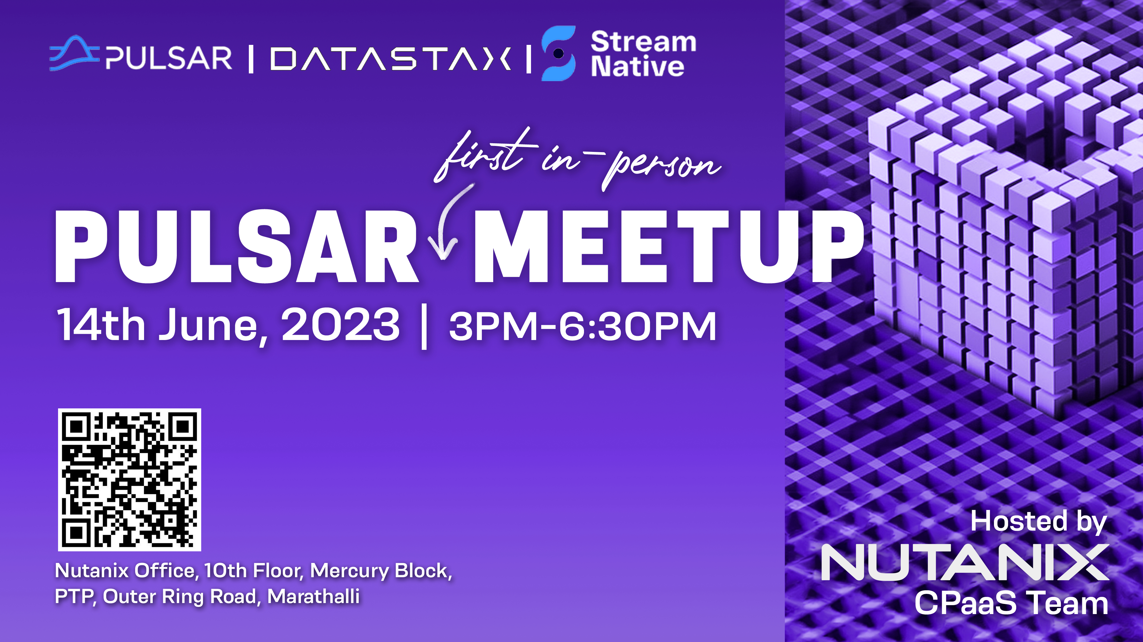

Slide 2
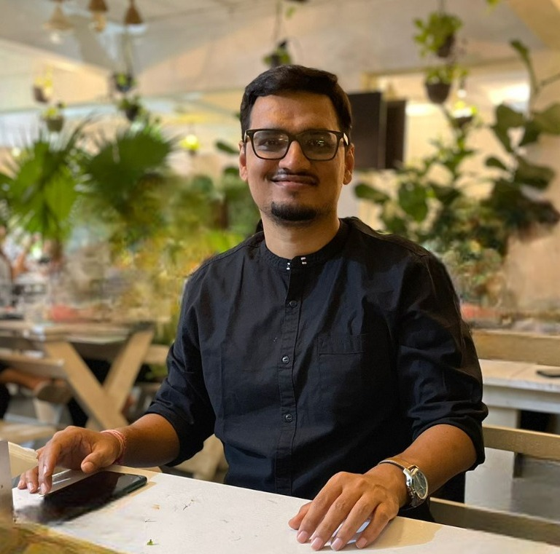
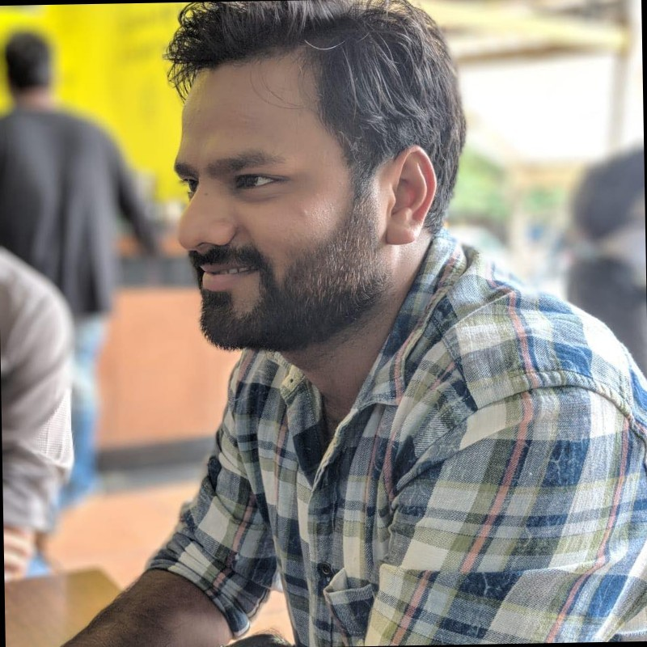
Who are we?
Shivji Kumar Jha
Staff Engineer at Nutanix,
Apache Pulsar Contributor
Sourabh Agrawal
MTS-4 at Nutanix
Staff Engineer, Cloud Data Platforms Team at Nutanix
Loves Distributed Systems
Open-Source fanatic
All my previous pulsar talks on my Youtube Playlist
Pulsar & MySQL Contributor
Loves Distributed Systems
SME for Apache Pulsar
Decade of experience with Apps, infra and cloud!

Slide 3
Legal Disclaimer
Forward Looking Statements
This presentation and the accompanying oral commentary may contain express and implied forward-looking statements, including, but not limited to, statements relating to: our business plans, initiatives and objectives; our ability to execute such plans, initiatives and objectives in a timely manner, and the benefits and impact of such plans, initiatives and objectives, including our ability to manage our expenses in future periods; our financial model targets and our plans to achieve those targets; the benefits and capabilities of our platform, products, services and technology; our plans and expectations regarding new products, services, product features and technology, including those that are still under development or in process; the timing of any product releases or upgrades or announcements; anticipated trends, growth rates and challenges in our business and in the markets in which we operate; our ability to develop new solutions, product features and technology and bring them to market in a timely manner, as well as the impact and/or benefits of including additional solutions or features in our product portfolio; market acceptance of new technology and recently introduced solutions; the interoperability and availability of our solutions with and on third-party platforms, including public cloud platforms; our ability to maintain and strengthen our relationships with our channel partners, OEMs and other third parties, and the impact of any changes to such relationships on our business, operations and financial results; the competitive market, including our competitive position and ability to compete effectively, our projections about our market share in future periods, the competitiveness of our future cost structure with those of other companies, and the competitive advantages of our products; our plans and timing for, and the success and impact of, our transition to a subscription-based business model; and macroeconomic trends and geopolitical environment, including the on-going global supply chain disruptions.
These forward-looking statements are not historical facts and instead are based on our current expectations, estimates, opinions, and beliefs. Forward-looking statements should not be considered as guarantees or predictions of future events. Consequently, you should not rely on these forward-looking statements. The accuracy of these forward-looking statements depends upon future events and involves risks, uncertainties, and other factors, including factors that may be beyond our control, that may cause these statements to be inaccurate and cause our actual results, performance or achievements to differ materially and adversely from those anticipated or implied by such statements, including, among others, the risks detailed in our most recent Annual Report on Form 10-K and Quarterly Reports on Form 10-Q, each as filed with the U.S. Securities and Exchange Commission, or the SEC, which should be read in conjunction with the information in this presentation and accompanying oral commentary. Our SEC filings are available on the Investor Relations section of our website at ir.nutanix.com and on the SEC's website at www.sec.gov. These forward-looking statements speak only as of the date of this presentation and accompanying oral commentary and, except as required by law, we assume no obligation, and expressly disclaim any obligation, to update, alter or otherwise revise any of these forward-looking statements to reflect actual results or subsequent events or circumstances.
Product or Roadmap Information
Any future product or roadmap information included in this presentation and the accompanying oral commentary is (i) intended to outline general product directions, (ii) not a commitment, promise or legal obligation for Nutanix to deliver any material, code, or functionality, and (iii) not intended to be, and shall not be deemed to be, incorporated into any contract. This information should not be used when making a purchasing decision. Further, note that Nutanix has made no determination as to whether separate fees will be charged for any future products, product enhancements and/or functionality which may ultimately be made available. Nutanix may, in its own discretion, choose to charge separate fees for the delivery of any future products, product enhancements and/or functionality which are ultimately made available.
Third Party Reports and Publications
Certain information contained in the presentation and accompanying oral commentary made available as part of this digital event may relate to or be based on reports, studies, publications, surveys and other data obtained from third-party sources and our own internal estimates and research. While we believe these third-party reports, studies, publications, surveys and other data are reliable as of the date of the applicable presentation, they have not independently verified, and we make no representation as to the adequacy, fairness, accuracy, or completeness of any information obtained from third-party sources.
Trademark Disclaimer
© 2022 Nutanix, Inc. All rights reserved. Nutanix, the Nutanix logo, and all Nutanix product, feature, and service names mentioned herein are registered trademarks or trademarks of Nutanix, Inc. in the United States and other countries. Other brand names or logos mentioned or used herein are for identification purposes only and may be the trademarks of their respective holder(s). Nutanix may not be associated with, or be sponsored or endorsed by, any such holder(s).

Slide 4







What do we do?
What we do at Nutanix!
Nutanix unifies public cloud simplicity with private cloud performance and security
Whether on-premises or hybrid, we’ll ensure business continuity through centralized management, one-click operations
More than 20,000 leading companies trust Nutanix
Supported Clouds
https://www.nutanix.com/

Slide 5

Apache Pulsar is a cloud-native, distributed, open-source pub-sub messaging and streaming platform.
Originally developed by Yahoo and contributed to the Apache Software Foundation in 2016.

Slide 6
Agenda
What we love about Pulsar after 4 years in production!
Pulsar Architecture
Segment Oriented Storage
Workload Isolation
Multi-Tenancy
Geo-Replication
Subscription Choices
Design Patterns
Challenges / Learnings
Apache Pulsar is a cloud-native, distributed, open-source pub-sub messaging and streaming platform.
Originally developed by Yahoo and contributed to the Apache Software Foundation in 2016.

Slide 7
Pulsar Architecture

Slide 8
Producer
Consumer
Pulsar lib
Pulsar lib
Dispatcher
Managed Ledger
Bookie Client
Bookie
Load Balancer
Global Replicator
Cache
Broker
Zookeeper
Picture Credits: https://pulsar.staged.apache.org/docs/assets/pulsar-system-architecture.png

Slide 9
Segment Based Storage

Slide 10
Topic
Partitioned Topic 1
Partitioned Topic 2
Partitioned Topic 3
Segment 1
Segment 2
Segment 3
Entry Log 1
Entry Log 2
Entry Log 3
Msg 1
Msg 2
Msg 3
Msg 4

Slide 11
Workload Isolation

Slide 12
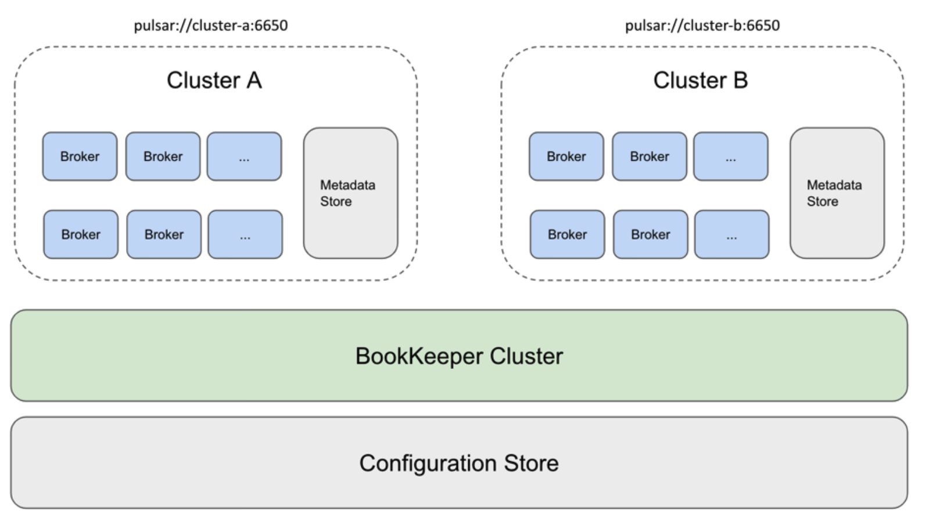
Broker Isolation
Metadata store: topic metadata, schema, broker load data, etc
Configuration store: clusters, tenants, namespaces, partitioned topic-related configurations, etc
Picture Credit - https://pulsar.apache.org/assets/images/isolation-1-67815ccbaa7aa9d6c95d9b53b6b8a2b9.png

Slide 13
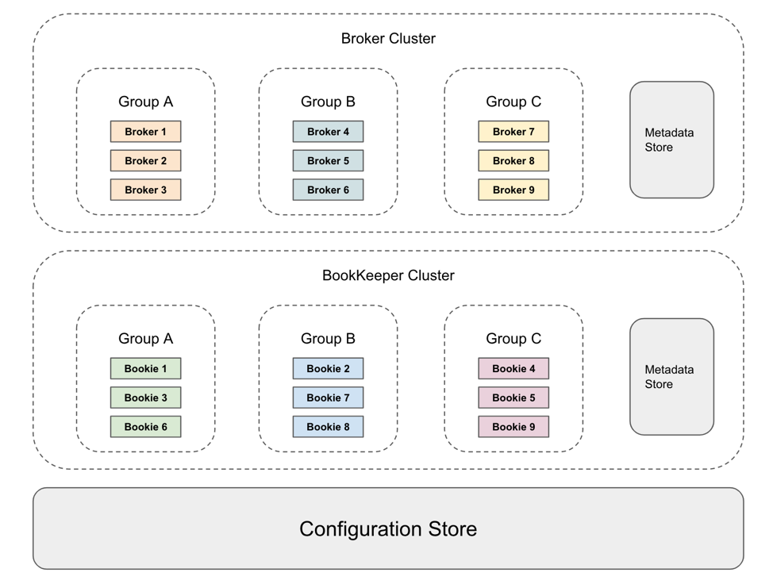
Namespace-A
Namespace-C
Broker Isolation
with ns-isolation
Namespace-A
Namespace-C
Picture Credits: https://pulsar.apache.org/assets/images/isolation-4-16f47c4aad3422d4e4c88b575939adfa.png

Slide 14
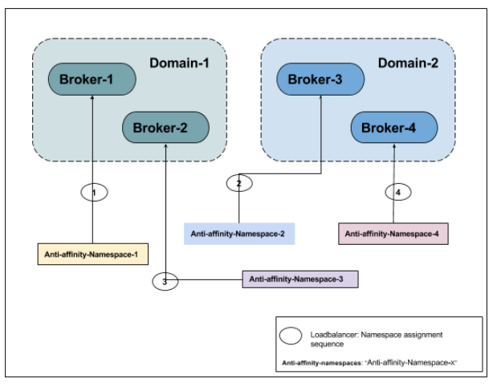
Broker Isolation
With Anti-affinity
Picture Credit - https://pulsar.apache.org/assets/images/isolation-1-67815ccbaa7aa9d6c95d9b53b6b8a2b9.png

Slide 15
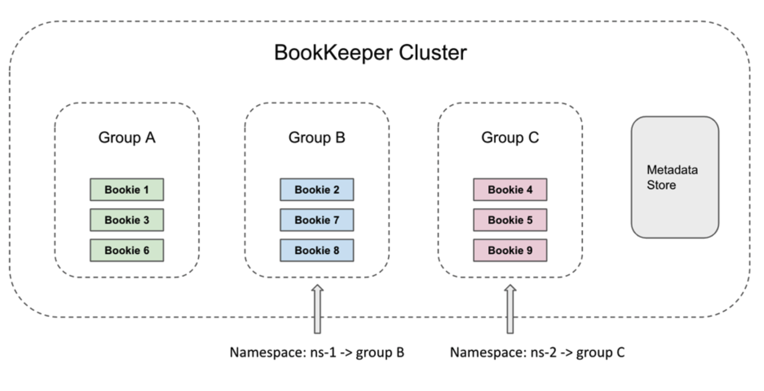
Bookie Isolation
Picture Credits - https://pulsar.apache.org/assets/images/isolation-3-b5d76b67b80f949373ff98aba9aff4c7.png

Slide 16
Multi-Tenancy

Slide 17
App
Eg: Swiggy / Zomato
Pulsar Cluster
Food
Grocery
Medicines
BusinessUnit/CostCenter
Tenants
Namespaces
Restaurant
Super Market
Pharma
Usecase/Teams
(Administrative unit)
Delivery
Topics
Take Away
Features/Microservices
Delivery
(autoCreate = true)
Take Away
Fine Dining
Take Away

Slide 18

Geo-Replication
This Photo by Unknown Author is licensed under CC BY-NC

Slide 19
us-east-1
us-west-1
Topic
T1
Topic
T1
Producer
P2
Producer
P1
Subscription
S1
Subscription
S1
Consumer
C1
Consumer
C2
Cluster- A
Cluster- B
Topic
T2
Producer
P3
Cluster- C
ap-south-1
Pcture Credits - https://pulsar.apache.org/assets/images/geo-replication-34036a887215513a9173d150f92e093e.png

Slide 20
Subscription Choices
Notes:
Kafa Consumer Groups vs Pulsar Shared Subscription, KIP-932

Slide 21
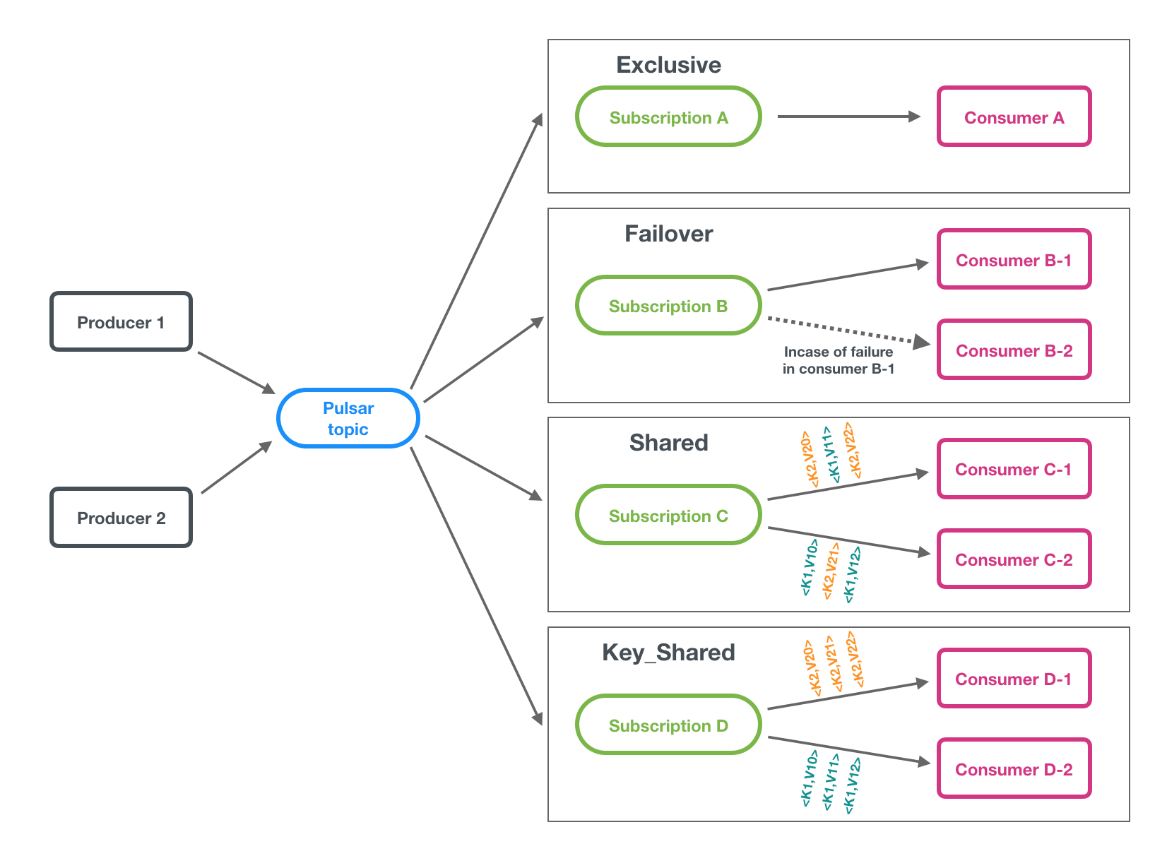
Picture Credit - https://pulsar.apache.org/assets/images/pulsar-subscription-types-664733b68c7124129ca7d0e04dedcb96.png

Slide 22
Design Patterns
Notes:
Kafa Consumer Groups vs Pulsar Shared Subscription, KIP-932

Slide 23
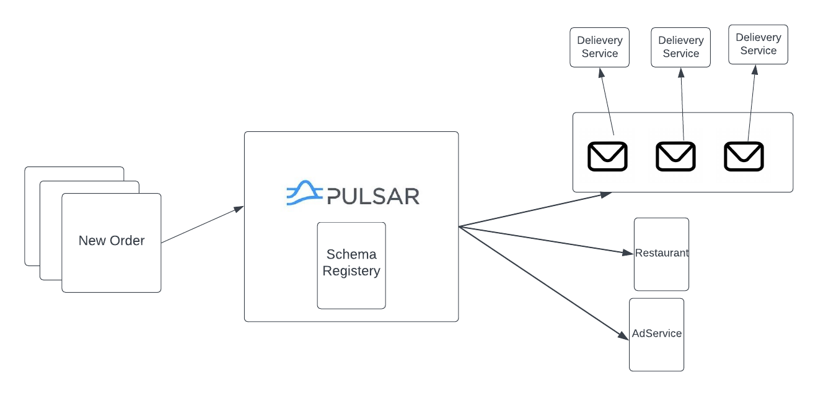
Streaming + Queueing

Slide 24
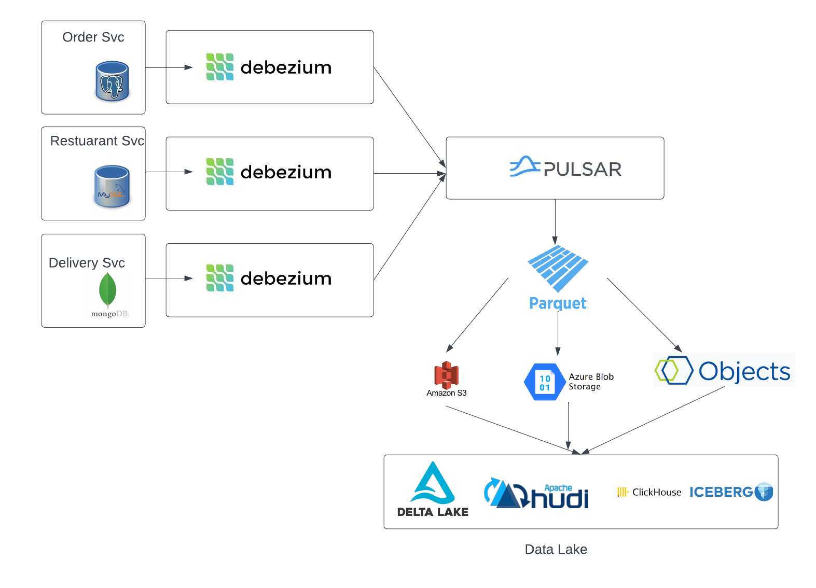
Pulsar-io-cloud-storage-connector
CDC

Slide 25
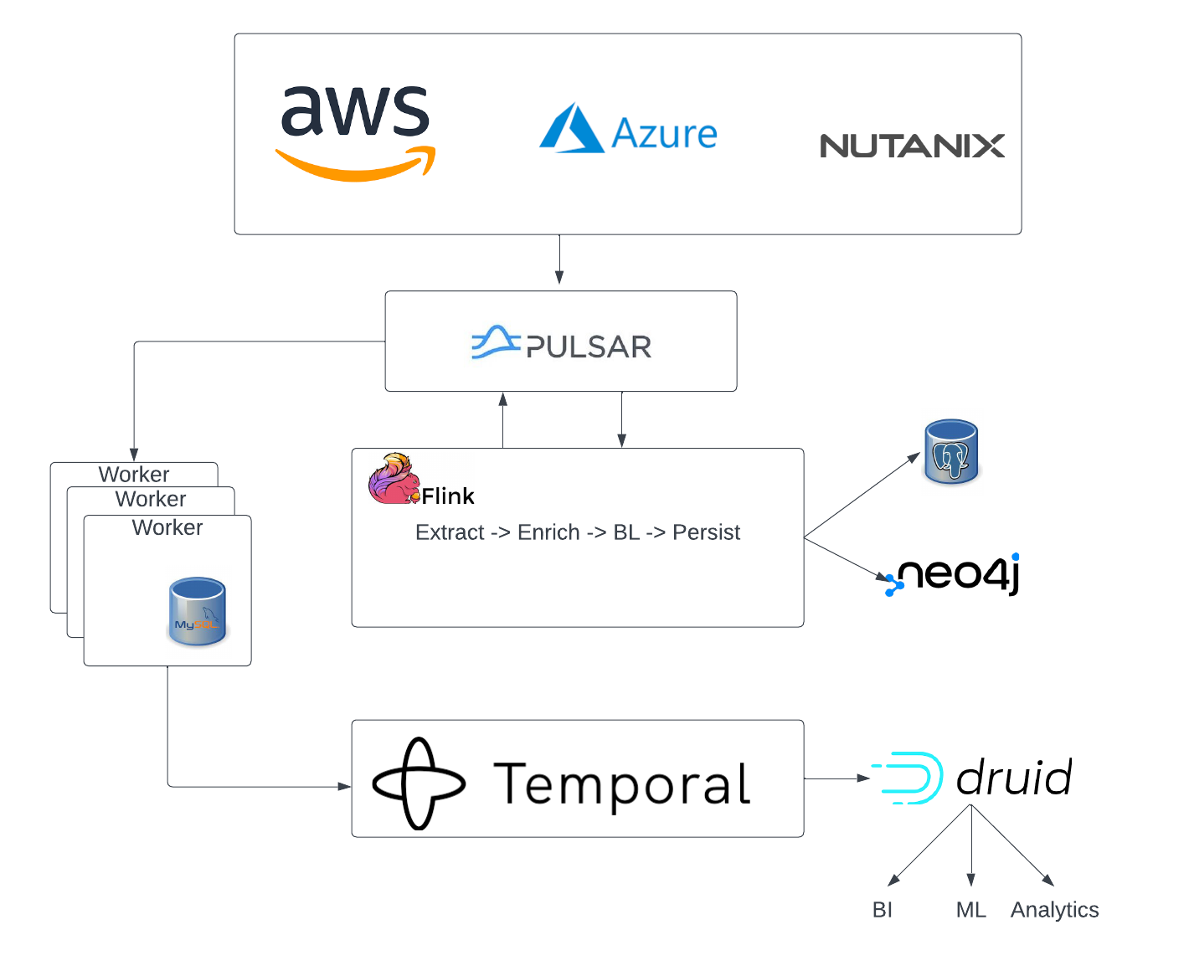
Streaming

Slide 26
Challenges / Learnings
Notes:
Kafa Consumer Groups vs Pulsar Shared Subscription, KIP-932

Slide 27
Rough edges around schema repository
Fixed & Open-sourced
No Authentication support in Flink connector
Fixed & Open-sourced
No Druid Connector
Workaround with KoP
Pulsar Admin UI needs more attention. We do use it in production!
Topic owned by 1 broker, no follower, issues with locality in cross region setups.
When you setup for the first time it might seem like a steep learning curve as a result of multiple modules (broker, bookkeeper and zookeeper).
Although modularity has its obvious advantages.
What matters in long term is daily operations and optimum resource utilization.
Last resort Streaming Choice!

Slide 28
Sounds Good! Where can I learn more?
Notes:
Kafa Consumer Groups vs Pulsar Shared Subscription, KIP-932

Slide 29
Pulsar Storage Internals :
Pulsar Summit NA 2021 : How Pulsar Stores your data
Workload Isolation Techniques in Pulsar and Setup
Pulsar Summit Asia 2021: Designing Pulsar Clients to Run in Isolation
KoP and a demo on how to workaround if no connector
Pulsar Summit Asia 2022: Streaming Wars and How Apache Pulsar is acing the battle
This talk also presents an engineering perspective on : Pulsar, Kafka, Kinesis and NATS
More on the flink based design and use cases
Pulsar Summit Asia 2022 : Keeping on top of hybrid cloud usage with Pulsar
CDC and Event Streaming on Apace Pulsar
EventSourcing 2021: Streaming App Changes to Event Store
Why we Chose Apache Pulsar:
StreamNative Webinar: Lessons From managing A Pulsar Cluster
Key Shared Subscription
Apache Pulsar Updates & Key Shared Subscriptions – August 11, 2021
Complete Playlist on Pulsar Internals
TGI Pulsar Playlist by Sijie Guo
https://pulsar.apache.org/docs

Slide 30




Thanks! Questions?
@shivjiJha
in/sourabhaggrawal/
Souravagrawal1111
in/shivjijha
shiv4289
shiv4289
Shivji Kumar Jha
Sourabh Agrawal

